Slide 1


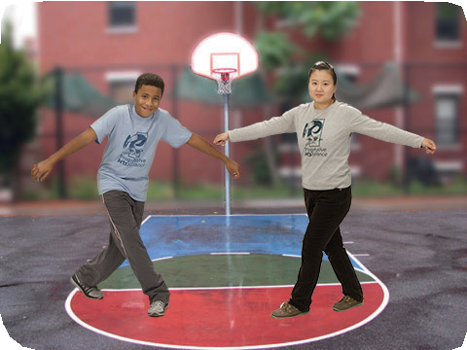
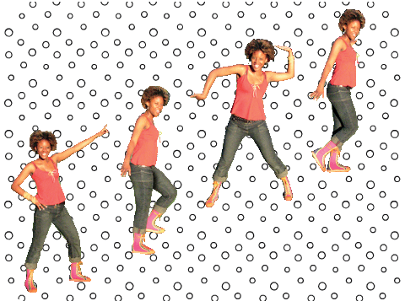
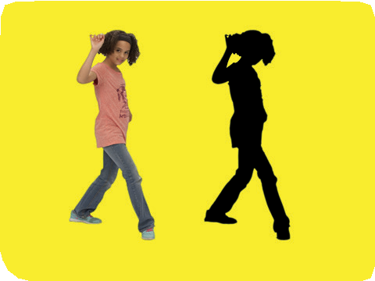
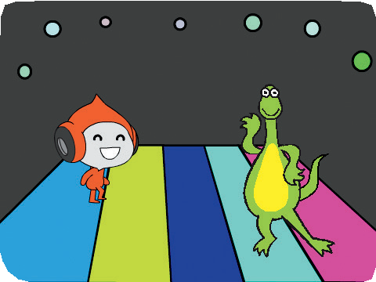


Let’s Dance Cards
Let’s Dance
Design an animated dance scene with music and dance moves.
scratch.mit.edu/dance

Slide 2
Let’s Dance Cards
Let’s Dance
Try these cards in any order:
Dance Sequence Dance Loop Play Music
Take Turns Starting Position Shadow Effect Leave a Trail Color Effect
Bop a Bit Interactive Dance
scratch.mit.edu/dance

Slide 3


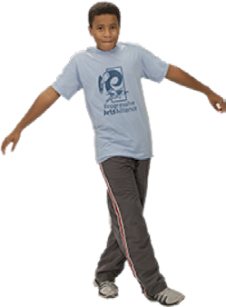

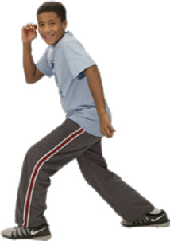
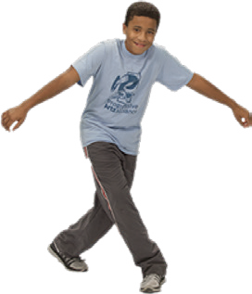
Dance Sequence
Dance Party!
Make an animated dance.
Let’s Dance
1

Slide 4



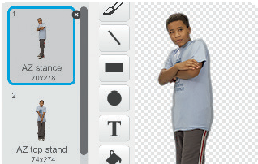


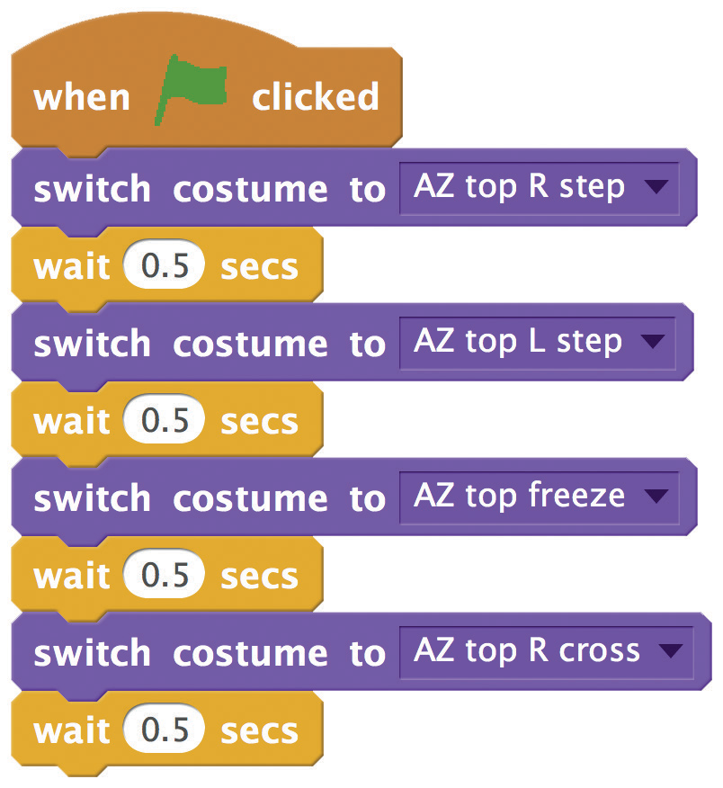

Dance Sequence
scratch.mit.edu/dance
GET READY
Choose a dancer from the Dance theme.
Click the tab to see the different dance moves.
ADD THIS CODE
Click the tab.
Choose a dance move.
Type how long to wait.
TRY IT
Click the green flag to start.

Slide 5




Dance Loop
Dance Party!
Repeat a series of dance steps.
Let’s Dance
2

Slide 6

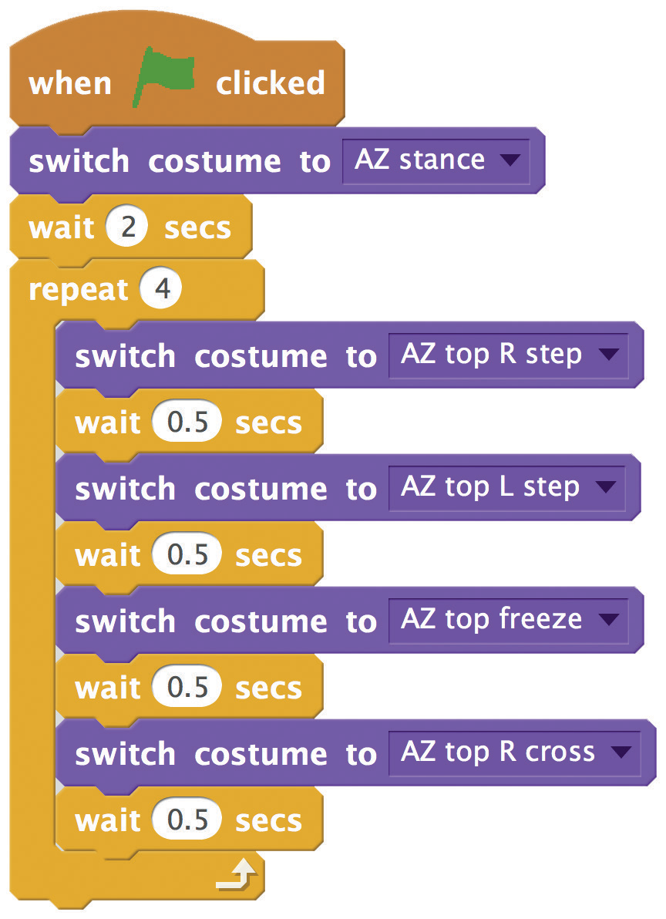

Dance Loop
scratch.mit.edu/dance
GET READY
Choose a dancer from the Dance theme.
ADD THIS CODE
Choose a dance pose.
Type how many times you want
to repeat the dance.
TRY IT
Click the green flag to start.

Slide 7
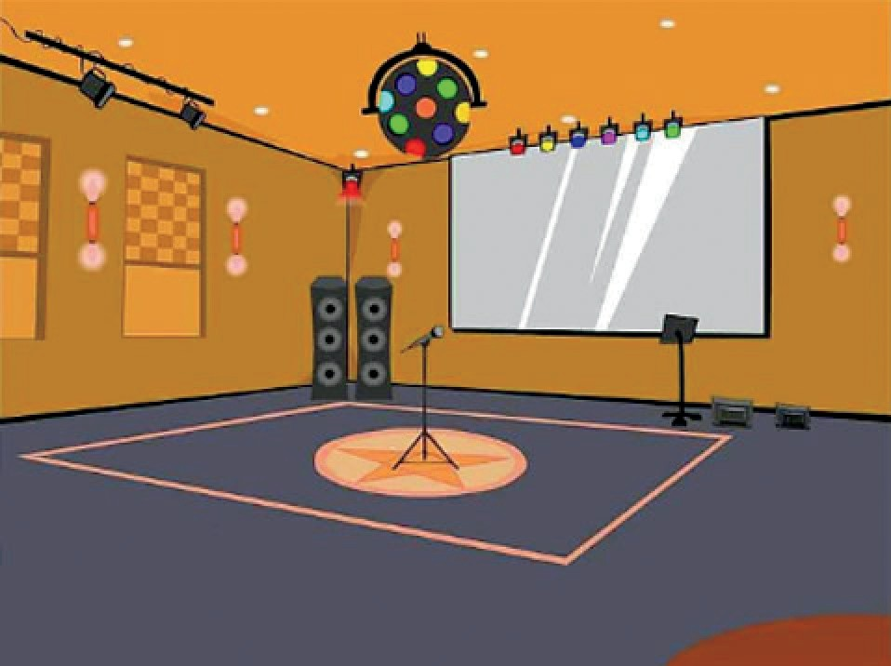
Play Music
Dance Party!
Play and loop a song.
Let’s Dance
3

Slide 8
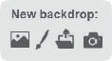

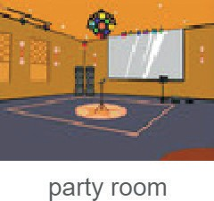

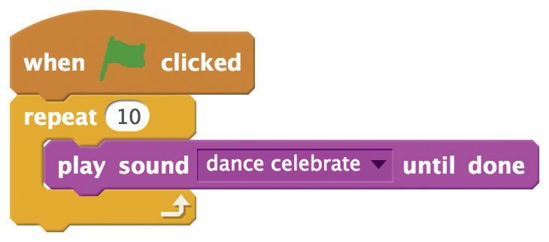


Play Music
scratch.mit.edu/dance
GET READY
Click the
tab.
Choose a backdrop.
Choose a song from the Music Loops category.
Or upload an MP3 or other sound file.
ADD THIS CODE
Click the tab.
Type how many times you want the song to repeat.
TIP
Make sure to use (not
or else the music won’t finish playing before it begins again.
)

Slide 9
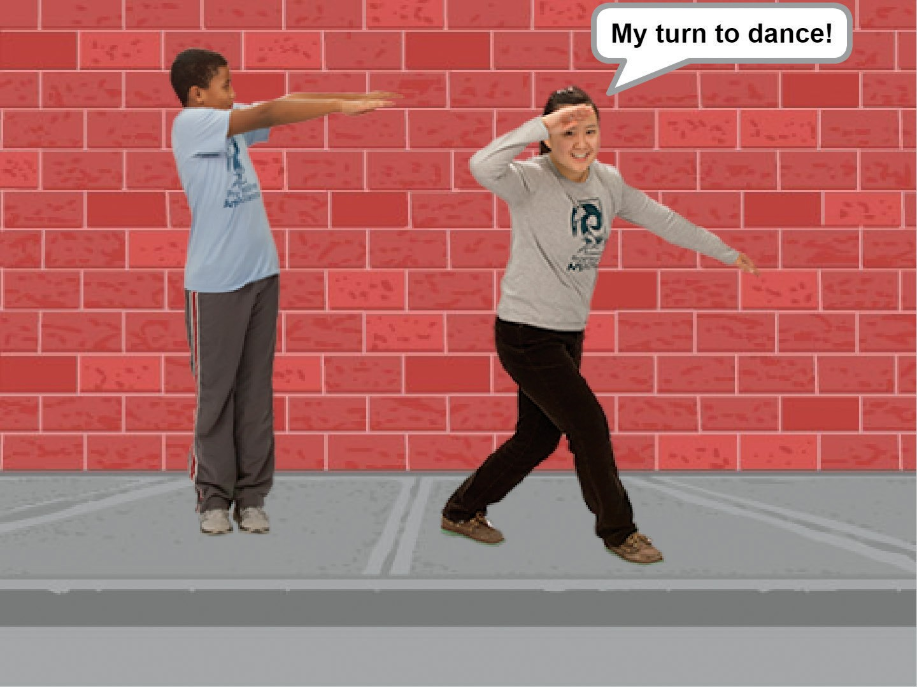
Take Turns
Dance Party!
Coordinate dancers so that one begins after the other.
Let’s Dance
4

Slide 10



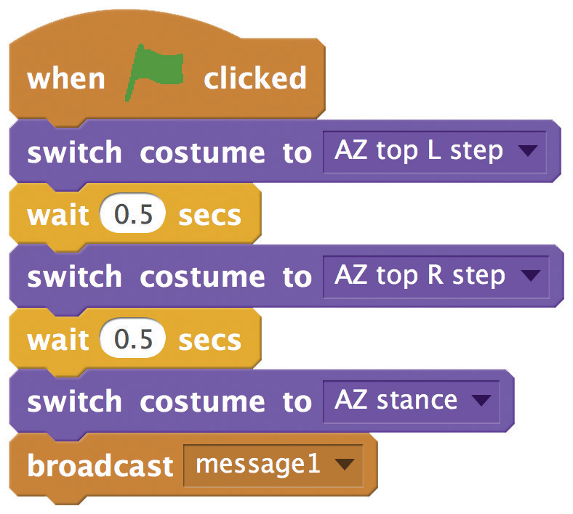

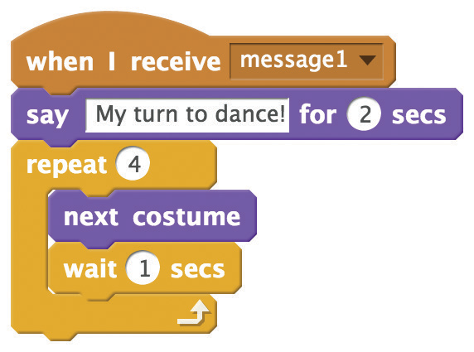


Take Turns
scratch.mit.edu/dance
GET READY
Choose two dancers from the Dance theme.
ADD THIS CODE
Broadcast a message.
Tell this dancer what to do when it receives the message.
TRY IT
Click the green flag to start.

Slide 11
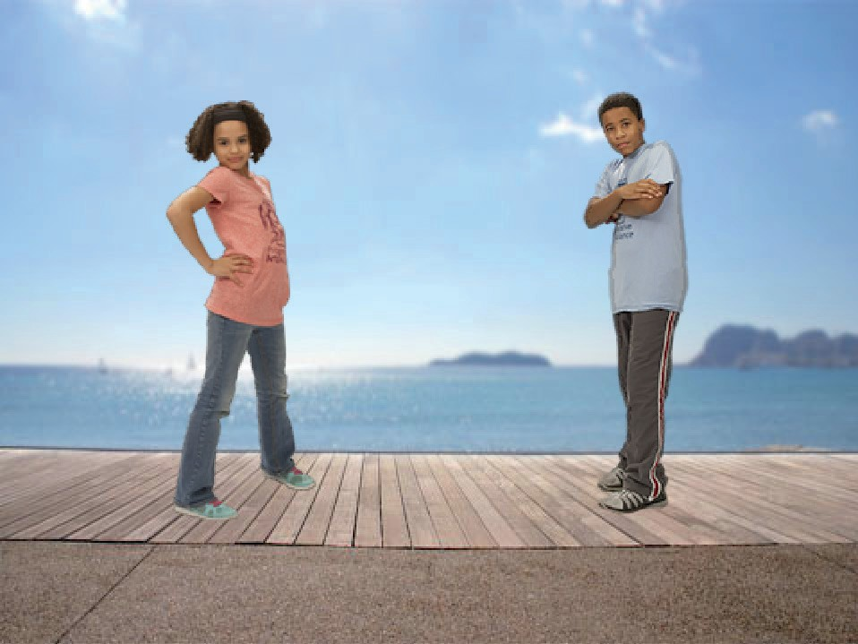
Starting Position
Dance Party!
Tell your dancers where to start.
Let’s Dance
5

Slide 12


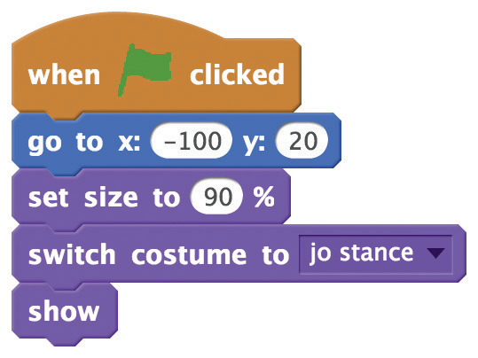

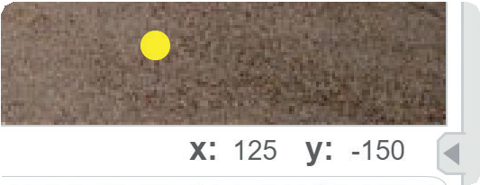
Starting Position
scratch.mit.edu/dance
GET READY
Choose a dancer that you want to start.
ADD THIS CODE
Tell it where to start. Set its size.
Choose the starting costume.
Make sure the sprite is showing (not hiding).
TIP
Use to set a sprite’s position on the Stage.
You can find an x and y position by pointing with the mouse pointer.

Slide 13
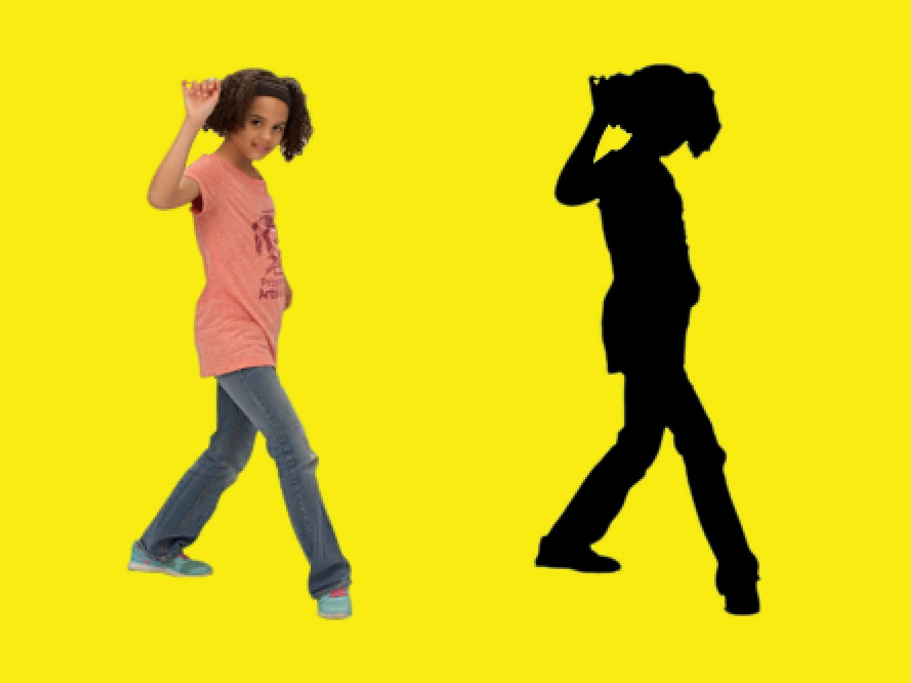
Shadow Effect
Dance Party!
Make a dancing silhouette.
Let’s Dance
6

Slide 14
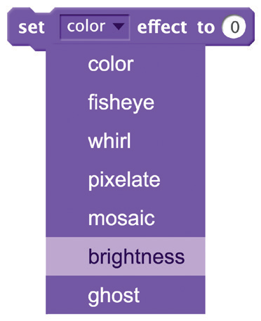
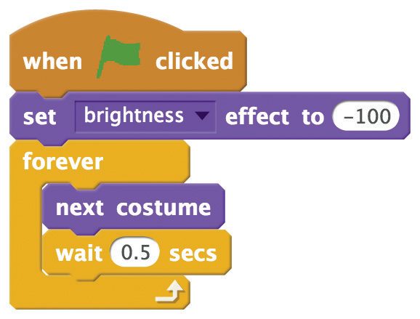

Shadow Effect
scratch.mit.edu/dance
GET READY
Choose a dancer from the Dance theme.
ADD THIS CODE
Choose brightness
from the menu.
Set the brightness to -100.
TRY IT
Click the green flag to start.
Click the stop sign to stop.

Slide 15
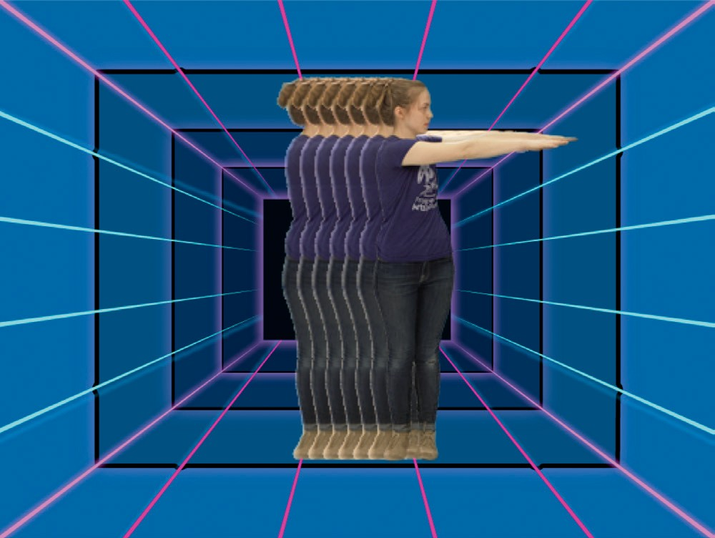
Leave a Trail
Dance Party!
Stamp a trail as your dancer moves.
Let’s Dance
7

Slide 16

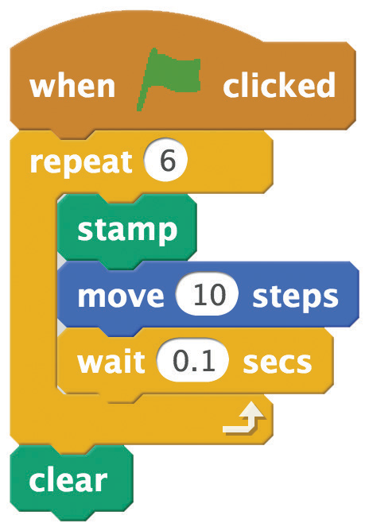

Leave a Trail
scratch.mit.edu/dance
GET READY
Choose a dancer from the Dance theme.
ADD THIS CODE
Type how many times to repeat.
Stamp the current costume on the Stage.
Clear all the stamps.
TRY IT
Click the green flag to start.

Slide 17
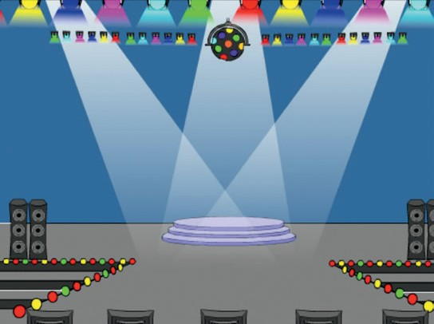
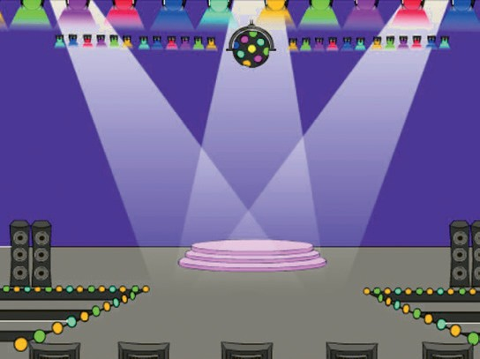
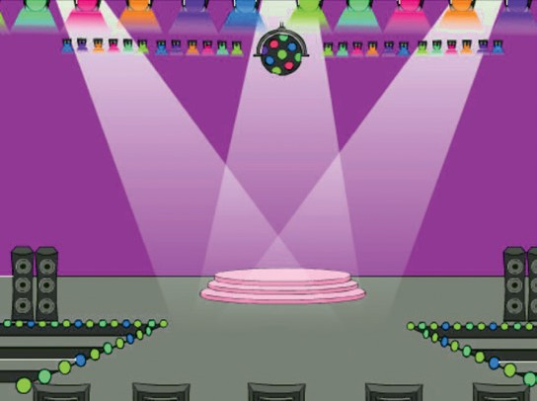
Color Effect
Dance Party!
Make the backdrop change colors.
Let’s Dance
8

Slide 18

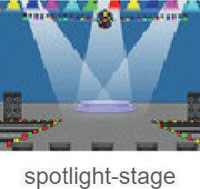
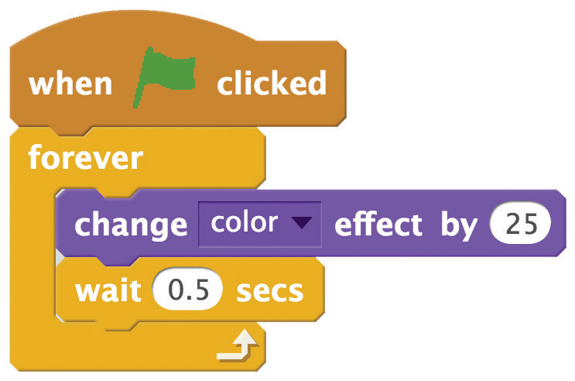


Color Effect
scratch.mit.edu/dance
GET READY
Choose a backdrop.
ADD THIS CODE
Click the tab.
Try different numbers.
TRY IT
Click the green flag to start.

Slide 19
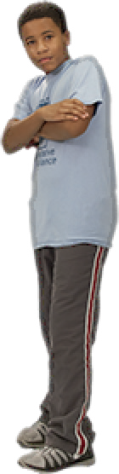
Bop a Bit
Dance Party!
Move your dancer up and down a little to look lively.
Let’s Dance
9

Slide 20
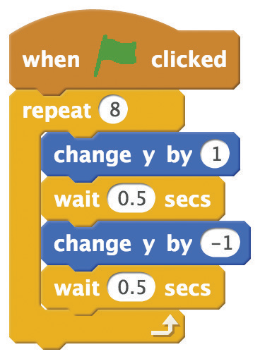


Bop a Bit
scratch.mit.edu/dance
GET READY
Choose a dancer from the Dance theme.
ADD THIS CODE
Type a positive number to move up.
Type a negative number to move down.
TIP
-1
1
To move up or down, you can use
.
1
-1
To move left or right, you can use
.

Slide 21
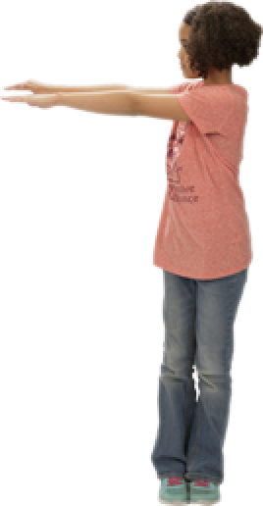
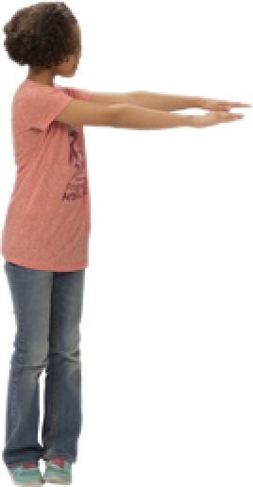

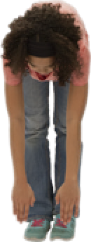
Interactive Dance
Dance Party!
Press keys to switch dance moves.
Let’s Dance
10

Slide 22
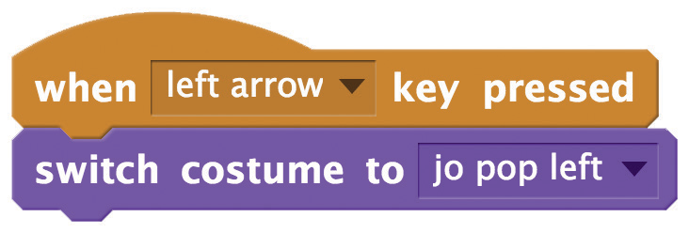
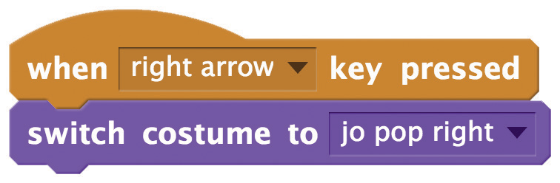
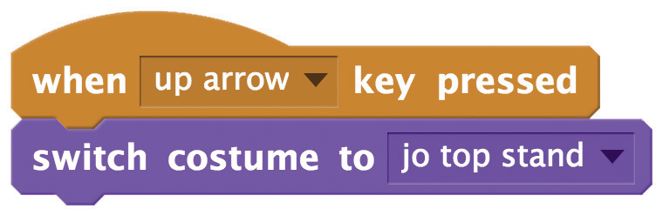

Interactive Dance
scratch.mit.edu/dance
GET READY
Choose a dancer from the Dance theme.
ADD THIS CODE
TRY IT
Press the arrow keys to make your dancer move.

